Slide 2
Indo china

Slide 3
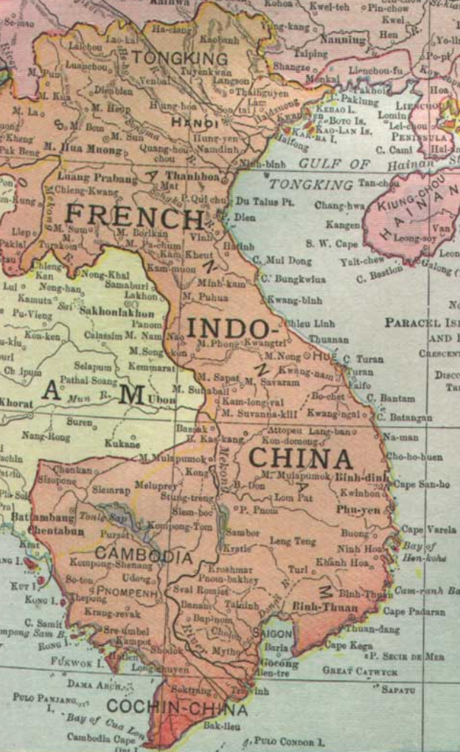
Indochina

Slide 4
Indochina Overview
Multiple kingdoms….unified/ independent. ….China dominance…as in Korea
“Created by French 1860…merging kingdoms Vietnam, Laos, Cambodia
Rise of Nationalism 1920’s
North Ho Chi Min ..Communist Party. CCP, USSR, pro Chinese, Buddhists
South/fragmented.. nationalists….pro west, Catholic elite, anti Chinese/
World War Two 1941-1945 Joint occupation Japanese/ Vichy French
Ho Chi Minh…leads anti Japanese from China
South minimal resistance
Post War Settlement
Japanese/ British reoccupy….hand over to returning French army

Slide 5
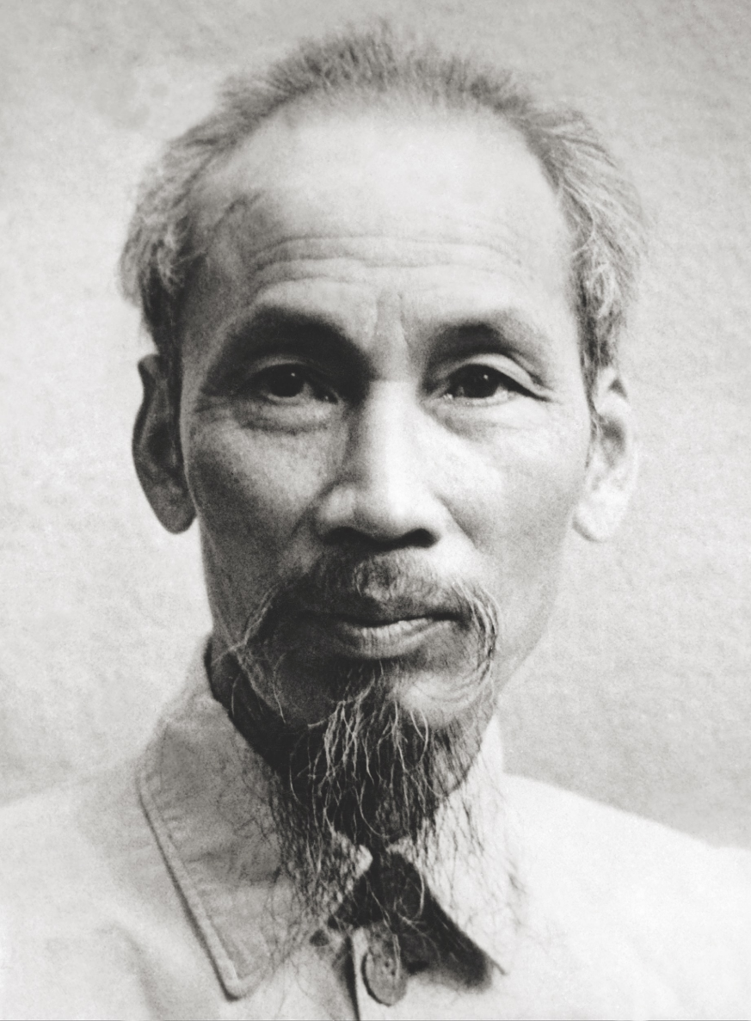
Ho Chi Minh (1890-1969)
Father Confucian priest
…French school Vietnam
... Attend college Paris
…no money, work on ships
Settles France…1917..studies
Communism…to USSR
Nationalist…joins Vietnamese
Independence movement
…Wilson refuses to meet him1919
…moves to USSR/then China
Joins Indochina Communists. Writer
…famous
To Vietnam 1941…leads Viet Minh

Slide 6
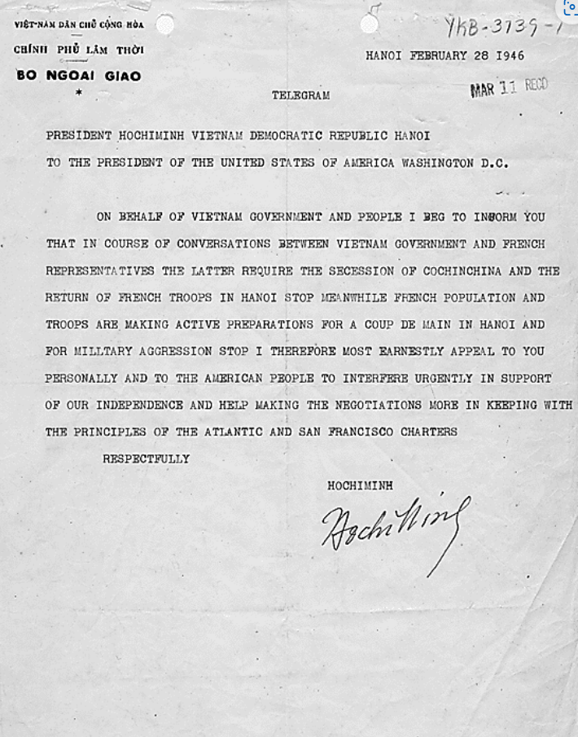
Ho Chi Min telegram to Truman
1945-46 Ho Chi Min launches campaign
of terrorism/murder vs “Nationalists". Others
Accommodating French/ Japan
Supported by US OSS (CIA)
…liberator…vacuum as Japanese surrender
Telegram to Truman….independence
US reject. Ho “communist” support French
return… “Republic of Vietnam”…
Vietminh….revolt…expand to South
French determine to unify/ destroy
Communists…Viet Minh

Slide 7
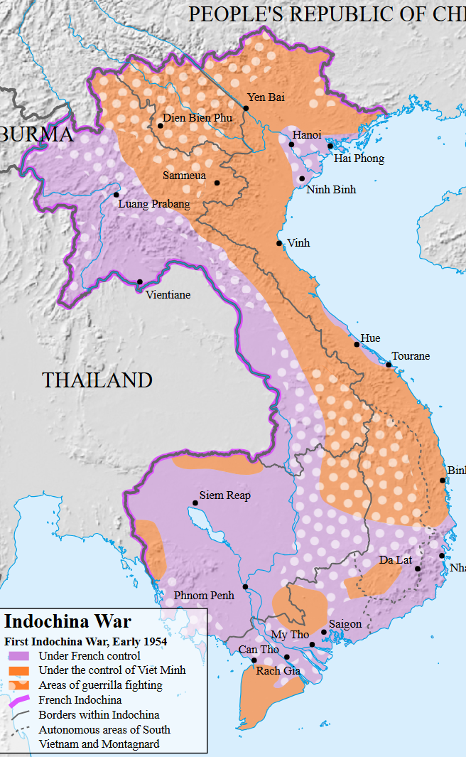
First Indo China War 1946-1954
French deploy 200,000,,,150,000
Vietnamese ….US provide funding
….Vietnam ….parallel to Korea
Vietminh..175,000 + 200,000 Vietnamese
French control cities….lose countryside
French “Forward plan 1954
…Army of 20,000 to Dien Bien Phu
…air attack, supply
…combine assault with Negotiations
Army trapped…..French ask U.S
for help…use of atomic bombs

Slide 8
US Response
Discussion on use of atomic bomb….over-ruled by Eisenhower
Vs land war Asia. Only intervene with British support
British reject…French problem…supporting failed model
Let French army fall….negotiate partition …as in Korea

Slide 9
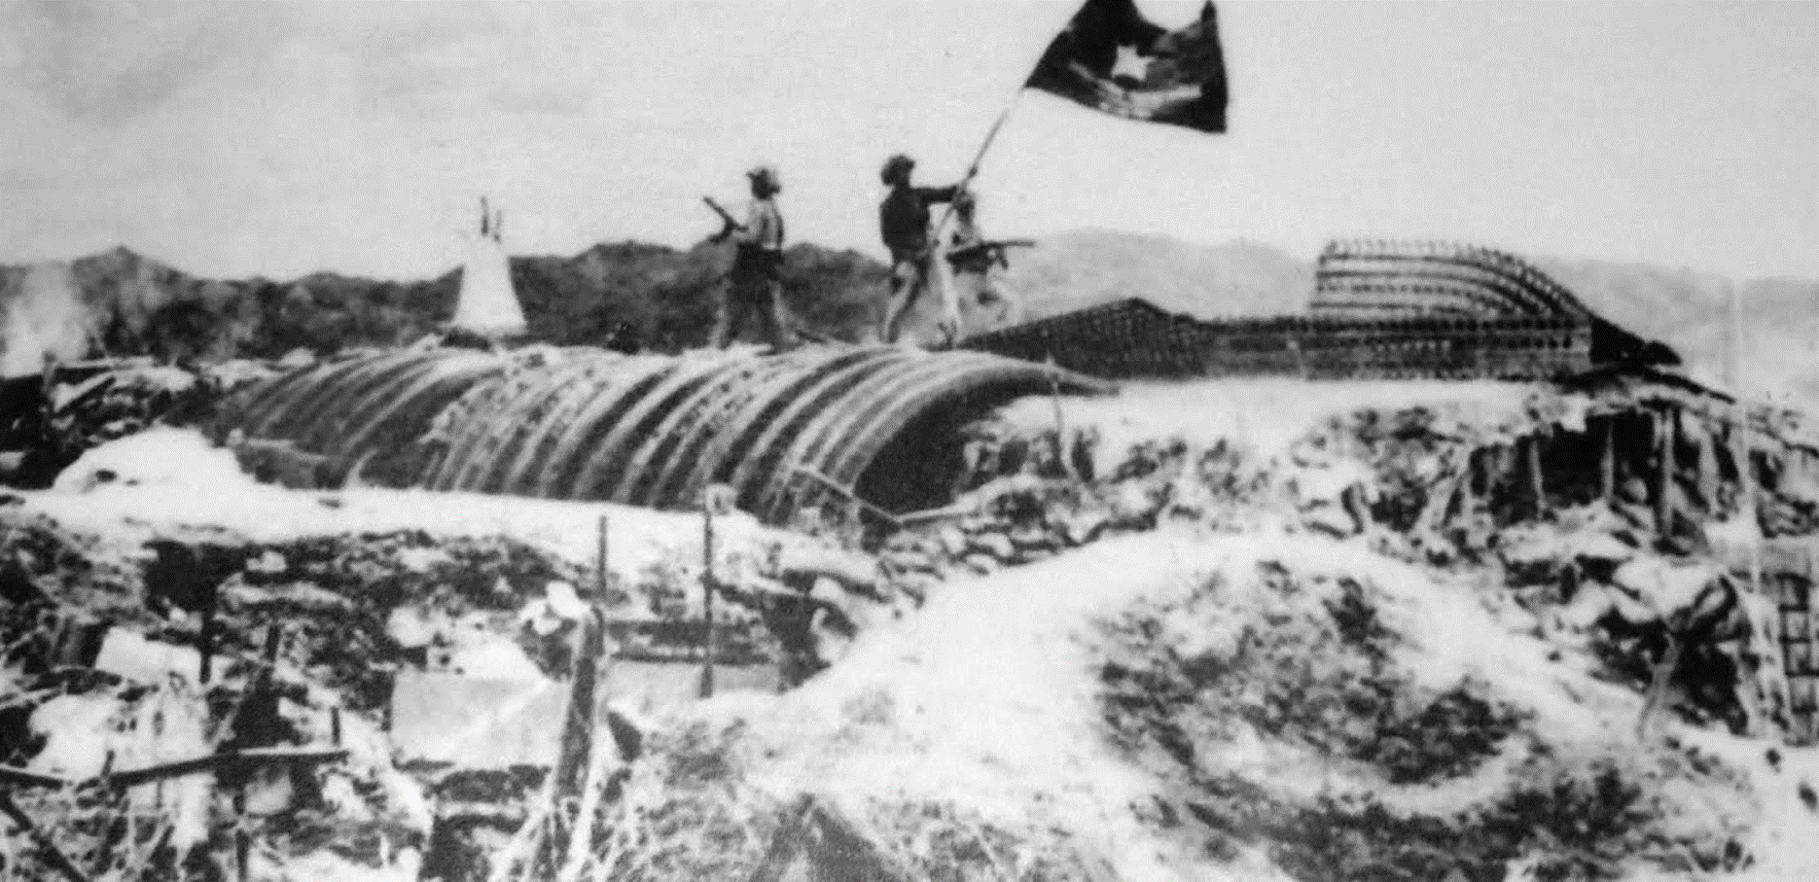
Dien Phen Phu 1954 …French army surrender 12,000 prisoners

Slide 10
Indochina: the deal
French withdraw
Viet Minh…Ho Chi Minh …North Vietnam
Nationalists…Bao Dao “King”.. Ngo Diem PM .
The idea: “Free and fair elections” across Vietnam then unity
Diem reject….Ho Chi Minh too popular
Outcome: two “dictatorships”
South….Diem depose emperor….establish dictatorship
North Ho Chi Minh….build communist state
Peasants revolt South (Viet Cong) ….civil war.
... Gaining ground despite US $

Slide 11
Domino Theory
"You have a row of dominoes set up, you knock over the first one, and what will happen to the last one is the certainty that it will go over very quickly," he said. "So you could have a beginning of a disintegration that would have the most profound influences.“
Communism must be contained
….South Vietnam the first domino

Slide 12
US and SE Asia 1954-1960
Support any Anti Communist “Strong Man". Ignore “movements”
Syhmgon Rhee – Korea
Chaing Kai Sheck – Taiwan
Ngo Diem..Vietnam (“family business”….corrupt…retain land)
….and others Dominica, Philippines, Nicaragua
Avoid use of land based US armies & direct conflict….Korea/ Indochina
Use indirect methods:
Financial payments/ adopt psychological warfare
Ally with elites. Land owners

Slide 13
Then, in 1956 …the balance is disturbed
Mid 1950’s Containment Strategy “working”
…… Communism contained
…….Europe, Asia, Central America stable

